Slide 1
The Celestial Sphere
Part 3 – Planets
Jim Johnson
HAL Astro School
May 7, 2020

Slide 2
Part 1 Topics:
  Celestial Sphere as the Apparent (2D) Universe vs the Actual (3D) Universe
  Angular measurements on the Celestial Sphere
  Definitions of Important Points and Circles on the Celestial Sphere
  Celestial Coordinate Systems
Part 2 Topics:
  Diurnal, seasonal, and annual motions of the celestial sphere and the Sun
  Lunar motions

Slide 3
Questions from Part 1 or Part 2?

Slide 4
Part 3 Topics
The Motions of:
  The Interior Planets
  The Exterior Planets
Time Permitting – Some finer points

Slide 5
Periods – Sidereal vs. Synodic
Sidereal– one orbit around the Sun with respect to the stars. View from Earth is irrelevant
Synodic – the period between two successive positions with respect to the Sun. View from Earth is relevant
Body | Sidereal Period | Synodic Period
Moon | 27.3 days | 29.5 days
Mercury | 88 days | 116 days
Venus | .6 years | 1.6 years
Mars | 1.9 years | 2.1 years
Jupiter | 11.9 years | 1.1 years
Saturn | 29.5 years | 1.03 years

Slide 6
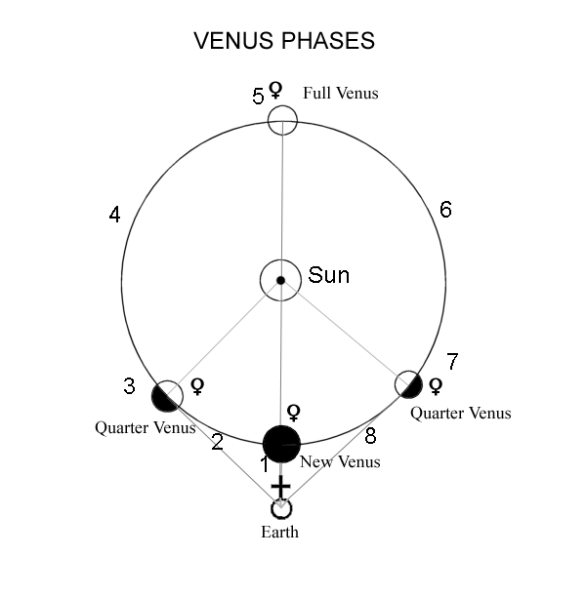
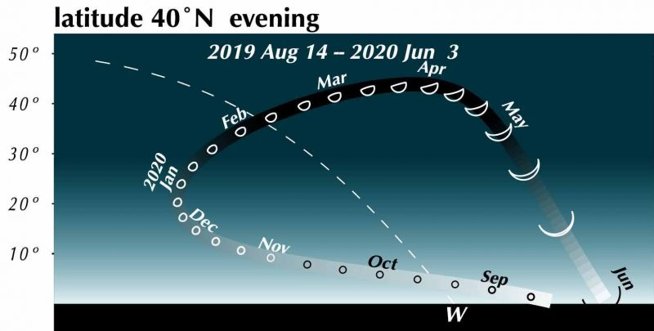
Venus
Inferior
Conjunction
Morning
Apparition
Evening
Apparition
Superior
Conjunction
www.earthsky.org
Maximum Eastern
Elongation
Maximum Western
Elongation
Orbital period: 225 days
Synodic period: 585 days
Orbital distance: 67 million miles
www.timingsolutions.com

Slide 7
Mercury
Similar to Venus except:
  Several apparitions each year. For the rest of 2020:
    June 4, 2020 Evening
    July 22, 2020 Morning
    Oct 1, 2020 Evening
    Nov 10, 2020 Morning
    Note alternating pattern
  Only visible for a few days around greatest elongation
  Morning apparition: in east the 30-45 minutes before sunrise
  Evening apparition: in the west 30-45 minutes before sunset

Slide 8
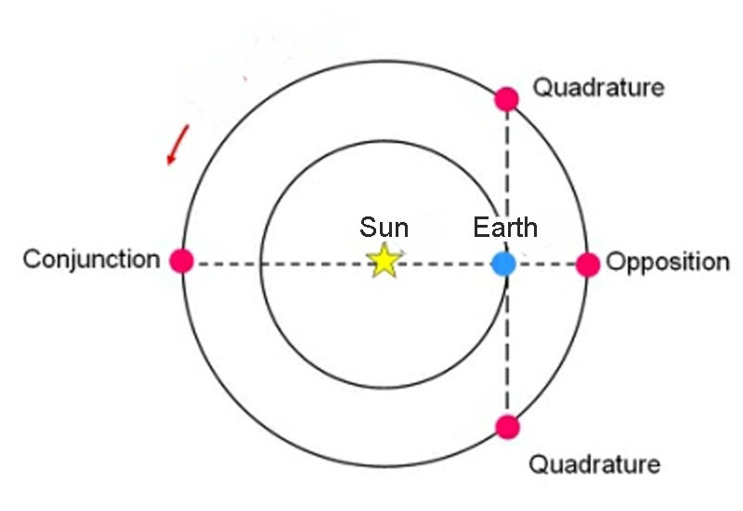
Exterior Planet Alignments
Conjunction - Planet is:
  Aligned with Earth and Sun
  On the far side of the Sun
  At its farthest distance from Earth
  At its smallest angular diameter
  Is elongated 0° from the Sun
  Rising at sunrise
  Cannot be viewed
Opposition - Planet is:
  Aligned with Earth and Sun
  On the Earth side of the Sun
  At its nearest approach to Earth
  At is largest angular diameter
  Is elongated 180° from the Sun
  Rising at sunset
  Best viewing opportunity

Slide 9
Exterior Planets in 2020
Opposition dates:
  Jupiter Jul 14, 2020
  Saturn Jul 20, 2020
  Mars Oct 13, 2020
Notes:
  Jupiter, Saturn, and Mars (in that order, west to east) are already rising well before sunrise, and will be in fairly close proximity all summer
  Jupiter and Saturn will be in a very tight conjunction on Dec 21, 2020

Slide 10
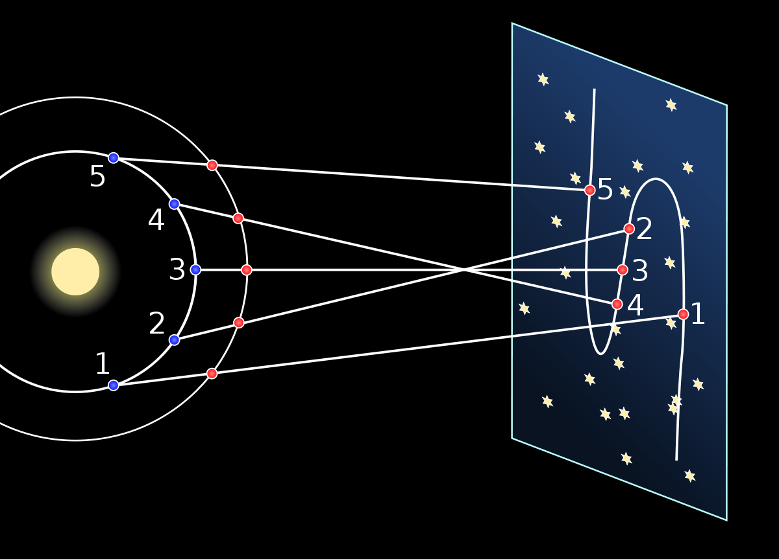
Prograde and Retrograde Motion
Prograde: A body’s ordinary motion eastward along the ecliptic
Retrograde: A body’s westward motion
  Moon – does not apply. It is always prograde
  Interior Planets – from greatest eastward elongation to greatest westward elongation
  Exterior Planets – while Earth is “passing” the other planet around opposition

Slide 11
Finer Points
Planetary alignments
  A deeper dive
  Jupiter and Saturn very close conjunction – December 21, 2020
Orion – an example of celestial rotation
An hour of Right Ascension represents an hour of celestial rotation
Deep Space Objects
  Fixed on the celestial sphere
  General guidance on where to find some of them

Slide 12
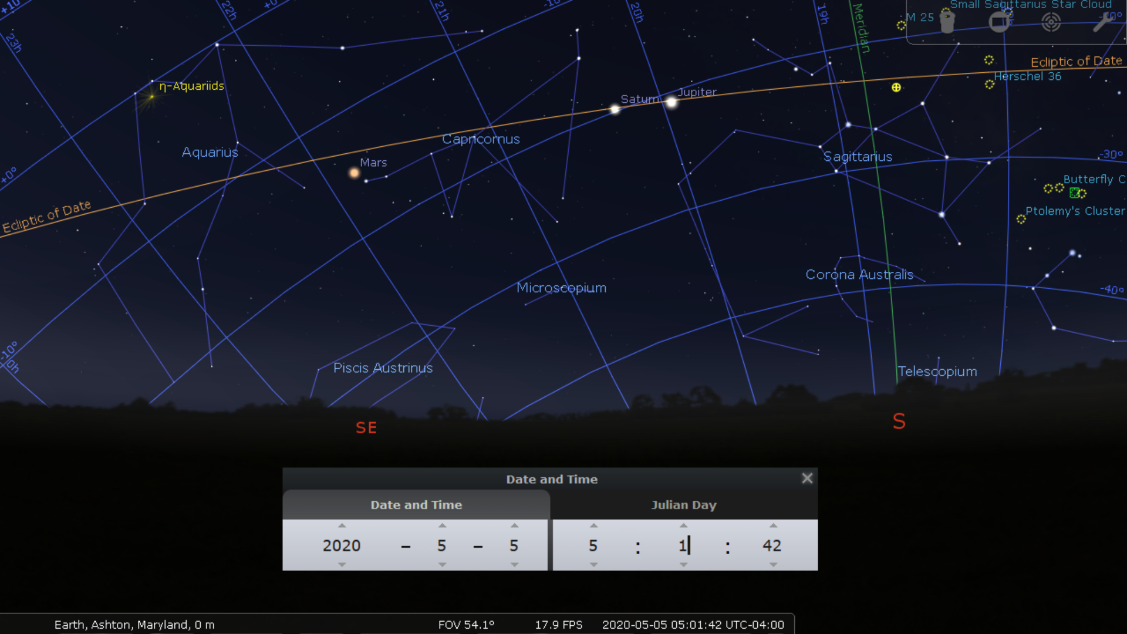

Slide 13
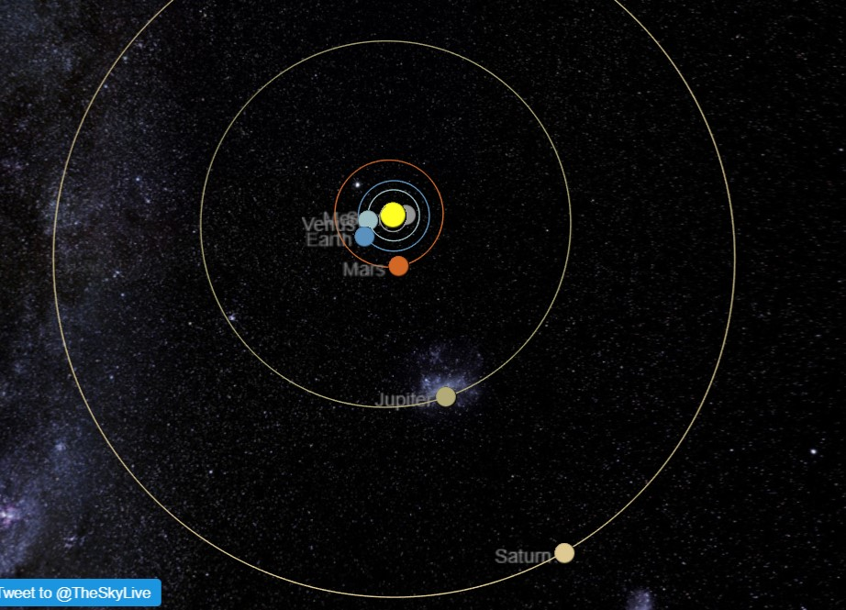
Solar System – Top Down View April 2020

Slide 14
Parting Words
Both the celestial sphere and planetarium apps are tools in the astronomer’s tool kit. Just like all of the other tools, one must have a through understanding of how they work in order to use them effectively. Moreover, repetition and frequency of use are the best ways to build this understanding. Being able to use tools effectively will ease frustration and increase one’s enjoyment of our hobby.
Clear skies!
Jim Johnson

Slide 15
Questions?

